Slide 1
Internal Developer Portal

Slide 2
Functional Requirements
User should be able to spin up ephemeral compute environment.
User should have option to manage lifecycle of environments.
Platform should be multi-tenant and tenants should be unable to see each other compute,logs and data.
User should be able schedule the data processing task.
IDP should be able to retry failed jobs.
Data processing task should have capabilities to push the results to storage
User should be able to trace the status of data jobs.

Slide 3
Non-Functional Requirements
High Availability
Scalable
Secure platform
Auditing and Observability
Logging and monitoring
Data encryption at rest and in transit

Slide 4
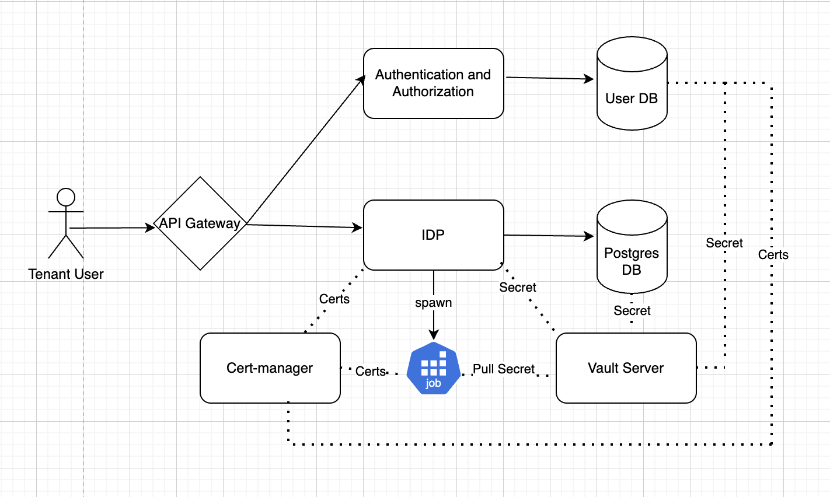
Overview
User will access the IDP portal and if not authenticated then API gateway will forward the request to Auth service.
Auth Service will authenticate the user- will use different Identity provider configurations configured during installation
User will access IDP APIs with token
Token signature will be verified and tenant information will be extracted
IDP will spawn a kubernetes job and persist metadata in Database.
Components
Internal Developer Portal Service
Vault Server
Cert manager
Authentication and Authorization Service
Databases

Slide 5
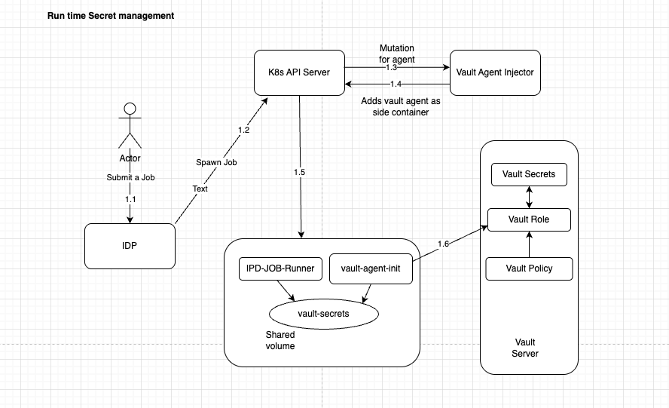
Secret Management
Hashicorp vault is installed to secure the platform secrets and tenant specific secrets
Secrets access is controlled by policies stored in vault
Secret injection in workloads (jobs/pods) is managed by vault init agent and vault agent based on requirement.
Vault-agent-injector mutate a pod and inject vault-agent-init/vault-agent in pod specification.

Slide 6
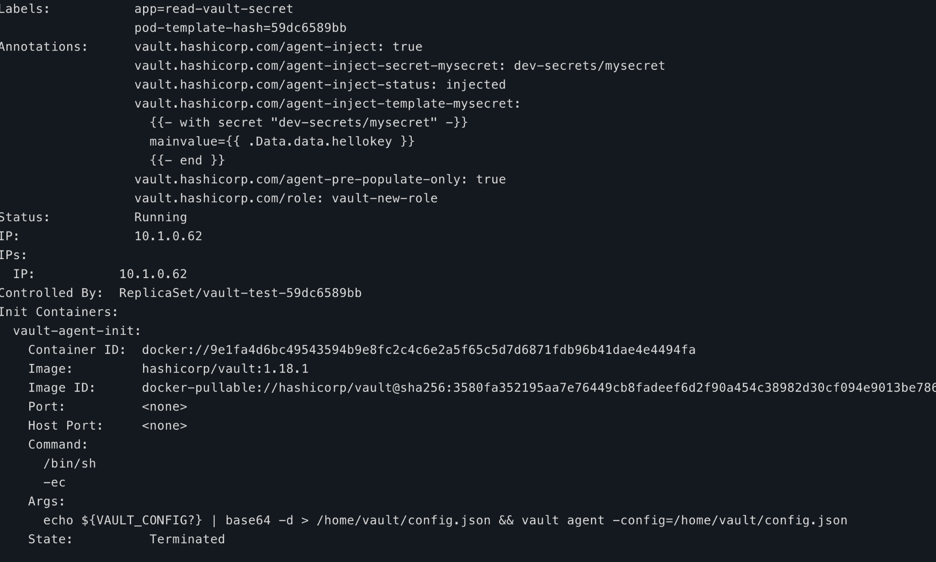
Example
Vault-agent-init is injected at the creation of pod
K8s service account is used for authentication in vault
Vault role is bound to policies which restrict secret access per tenants or common secrets
Vault server share the secrets to vault client created in vault-agent which can be mounted in volume/env in container
Secrets will remain in ephemeral storage of container and will be available till the lifecycle of container.

Slide 7
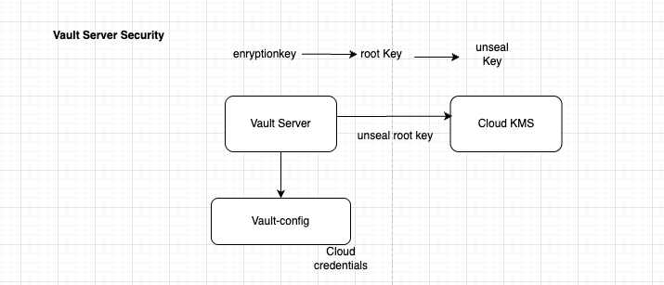
Vault Server Security
Vault data is encrypted by encrypted key
Encrypted Key is secured by root key
Root key is secured by unseal keys which is further secured by Cloud KMS key
Cloud credentials are provided in vault-config.
At each restart vault-server sealed the data, so it need to connect to Cloud to unseal root key, which provide the decryption key to vault for decryption of data.

Slide 8
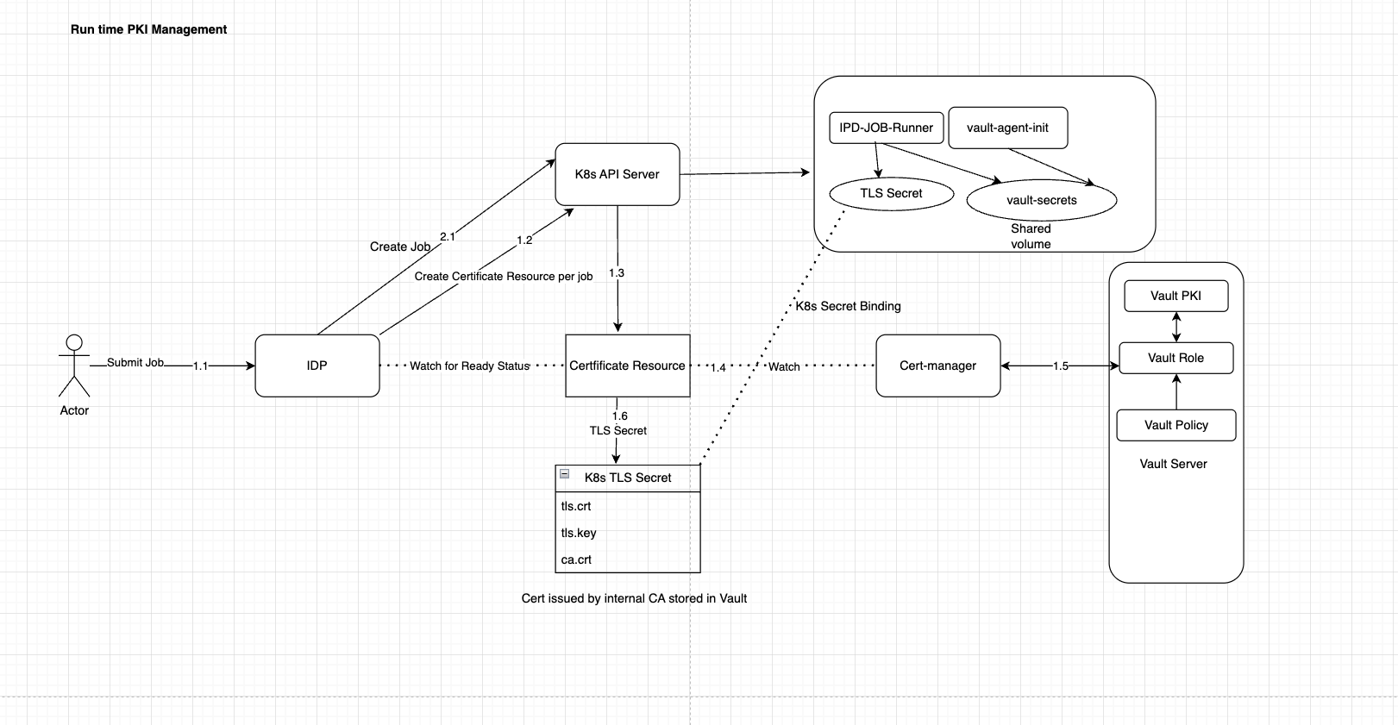
PKI Management
Cert manager is used for securing PKI infrastructure for platform
Cert manager will create a Kubernetes TLS secret having key/cert pair and trust to connect to different services.
Root CA is secured in Cloud KMS
Intermediate CA is created in vault and used as issuer in cert-manager
Certificate Resource is created in cluster during deployment for platform components (like database, idp) and also by IDP service for ephemeral compute resource (k8s Job)
Each component will be running with mTLS enabled and certs will be provided by vault issuer.
Vault server and Cert manager are considered as bootstrap services for platform for which certs will be minted offline under a different CA hierarchy and secured in Cloud KMS.

Slide 9
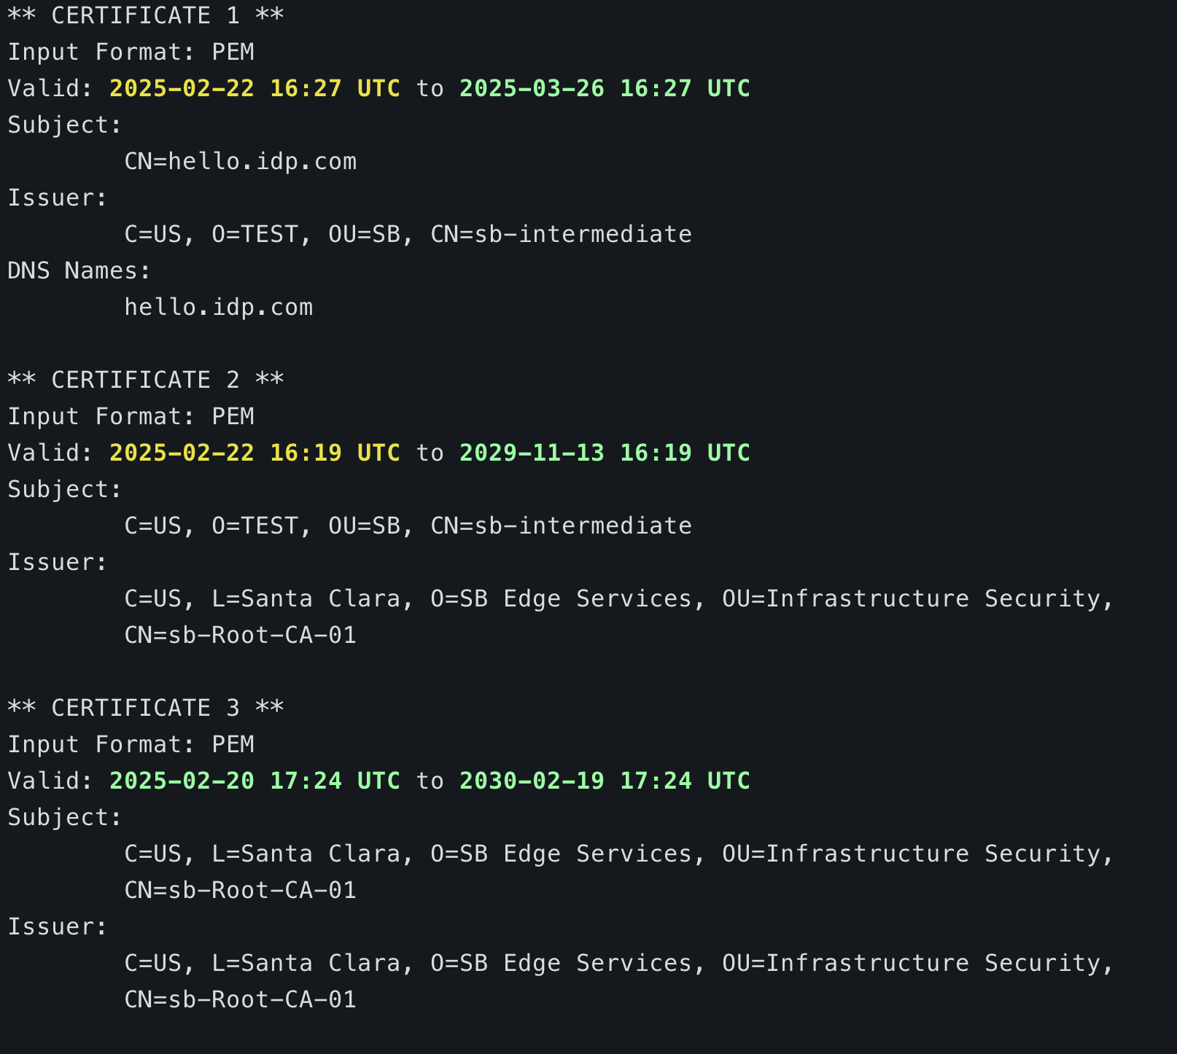
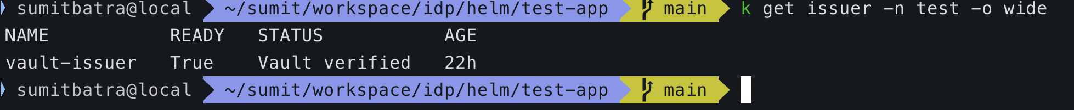
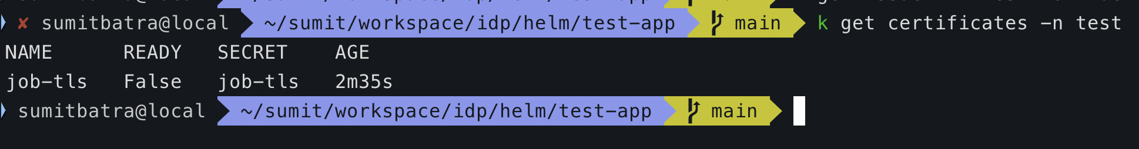
CA Hierarchy

Slide 10
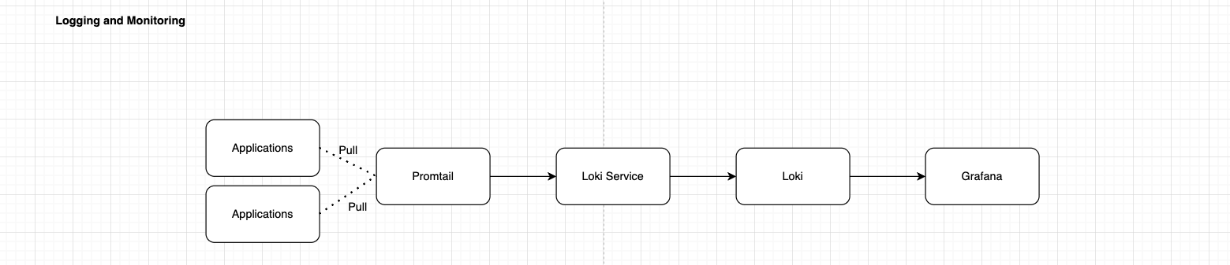
Logging and Monitoring
Applications (platform and jobs) logs are pulled by promtail
Promtail forward the logs to Loki service
Loki is used to store logs
Grafana is integrated with Loki as Datasource for logs
Logs are filtered by tenant and shipped in S3 for SLA requirements.

Slide 11
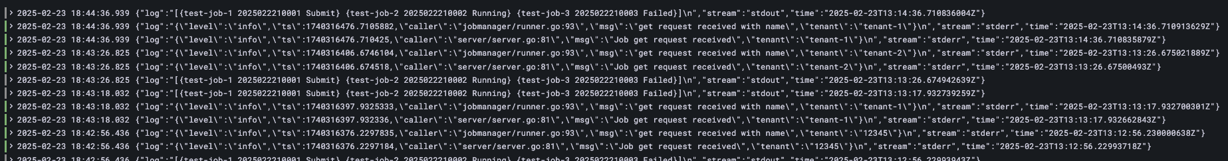
Sample Logs
Logs can be search based on different query filter available as fields in log messages
Logs will be stored in archival storage to meet the SLA requirements, audit logs for longer duration (30 days), debug logs (7 days)

Slide 12
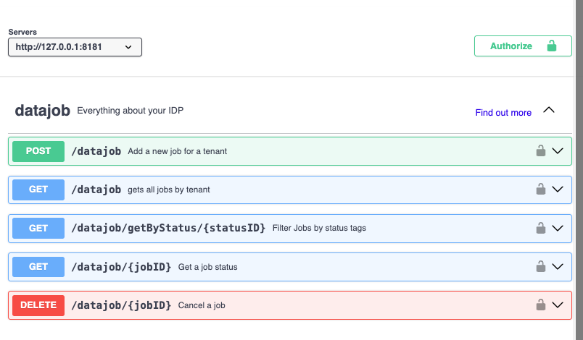
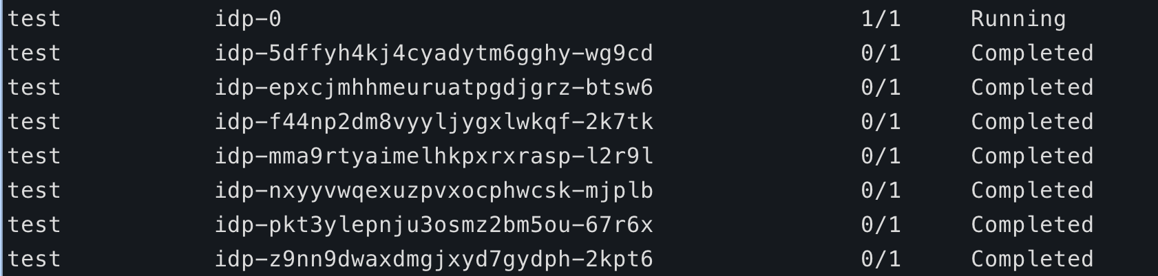
Internal Developer Portal
APIs to manage lifecycle of compute environments per tenant
Responsible for processing user requests for managing data processing tasks
APIs are restricted to access with token and signature validation of token will be done to extract tenant information
Responsible to save state for each user data processing task.
Created as stateful set to maintain lifecycle for data processing jobs.

Slide 13
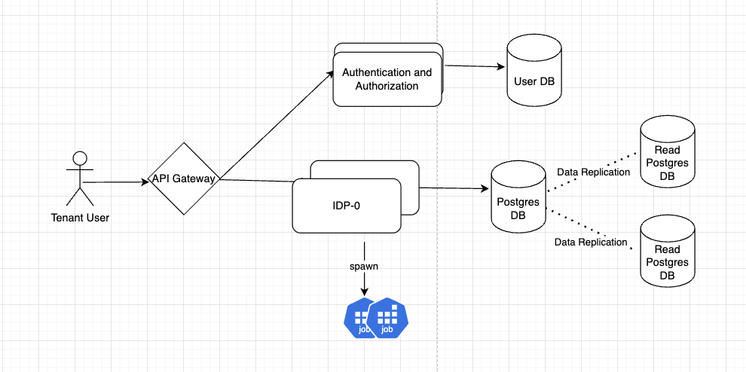
Continue…
IDP is horizontal scalable to extend platform as per requirement
Relational database is used to persist the data processing task events.
IDP will manage the life-cycle of compute env and update the status against each job id.
IDP will retry and schedule for failed jobs.

Slide 14
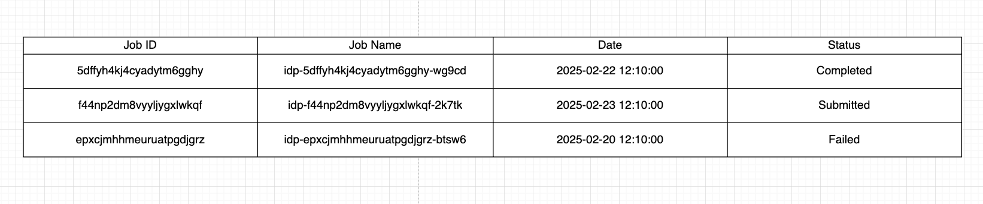
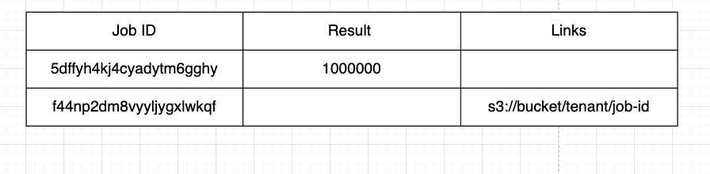
Database schema

Slide 15
Extended Features
Multi-region support
Database Sharding
Compliance checks to meet Security Standard (Fedramp, SOC2)
CICD pipeline to ensure quality and automatic deployment

Slide 16
Thank you

